Slide 1
DEEP LEARNING​

Slide 2
Agenda
Introduction​
Definition of deep learning​
Importance and applications of deep learning​
Neural Networks​
Overview of neural networks​
How neural networks work​
Types of neural networks (feedforward, recurrent, convolutional)​
Deep Learning Architectures​
Overview of deep learning architectures​
Convolutional neural networks (CNN)​
Recurrent neural networks (RNN)​
Generative Adversarial Networks (GAN)​

Slide 3
Agenda
Training Deep Learning Models​
Overview of training deep learning models
Common techniques (backpropagation, gradient descent, Adam optimization)
Common challenges (overfitting, underfitting)
Applications of Deep Learning​
Computer vision (image classification, object detection)
Natural Language Processing (NLP)
Robotics
Self-driving cars
Conclusion​
Recap of key points
Future of deep learning
Resources for further learning.

Slide 4
Introduction
Definition of deep learning
Importance and applications of deep learning

Slide 5
Definition of deep learning
Deep learning is a subset of machine learning that uses artificial neural networks with multiple layers, also known as deep neural networks, to analyze and process large amounts of data.
These networks are designed to simulate the way the human brain processes information, allowing them to learn and adapt to new patterns and data over time.
Deep learning is commonly used in tasks such as image and speech recognition, natural language processing, and predictive analytics.

Slide 6
Importance of deep learning
Deep learning is a subset of machine learning that utilizes artificial neural networks with multiple layers, also known as deep neural networks, to perform tasks such as image and speech recognition, natural language processing, and decision making.
One of the key advantages of deep learning is its ability to learn from vast amounts of data, making it suitable for complex and high-dimensional problems that are difficult for traditional machine learning algorithms to solve.

Slide 7
Importance of deep learning
Deep learning also has the ability to identify patterns and features in data that are not immediately obvious, and can even improve its performance over time through continued training. This makes it particularly useful in applications such as image and speech recognition, where the accuracy of the model can be improved as more data is gathered.
Another important aspect of deep learning is its ability to perform tasks that are difficult or impossible for humans to do, such as analyzing large amounts of medical data to identify patterns and make predictions. This makes it a powerful tool in fields such as healthcare, finance, and transportation.

Slide 8
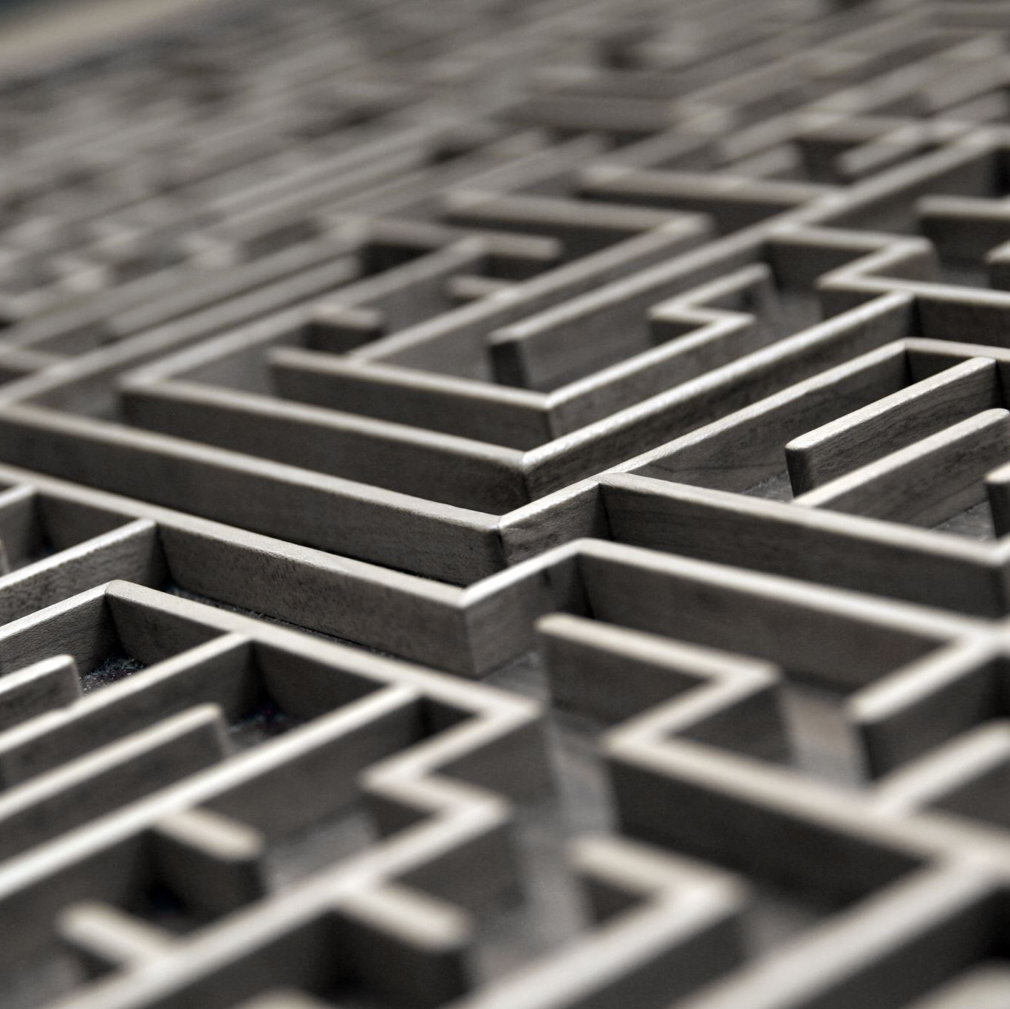
Importance of deep learning
In summary, deep learning is an important and powerful tool that can be used to solve complex and high-dimensional problems, improve performance over time, and perform tasks that are difficult or impossible for humans to do.

Slide 9
Applications of deep learning
Deep learning is a subset of machine learning that involves the use of artificial neural networks (ANNs) to analyze and interpret data. It is considered a key technology in the field of artificial intelligence (AI) and has a wide range of applications in various industries.
Computer Vision: Deep learning is widely used in computer vision applications such as image and video analysis, object detection, and facial recognition. It can be used to analyze images and videos, identify objects and faces, and even perform tasks such as tracking and recognition.
Natural Language Processing (NLP): Deep learning is also used in NLP applications such as text classification, sentiment analysis, and language translation. It can be used to analyze text, identify patterns and topics, and even generate new text.

Slide 10
Applications of deep learning
3.Speech Recognition: Deep learning is used to improve speech recognition systems by analyzing audio data and identifying patterns in speech. This can be used to improve voice-controlled assistants and transcription services.
4.Healthcare: Deep learning is used in healthcare to analyze medical images, such as X-rays and MRIs, and identify patterns that can indicate disease or injury. It can also be used to analyze patient data and provide personalized treatment recommendations.
5.Robotics: Deep learning is used to improve the performance of robots by allowing them to learn from experience and adapt to new situations. This can be used to improve the accuracy and reliability of robotic systems in industries such as manufacturing and logistics.

Slide 11
Applications of deep learning
Overall, deep learning has the potential to revolutionize many industries by providing more accurate and efficient ways of analyzing and interpreting data.
It is a key technology in the development of AI and is expected to have a significant impact on many areas of our lives in the future.

Slide 12
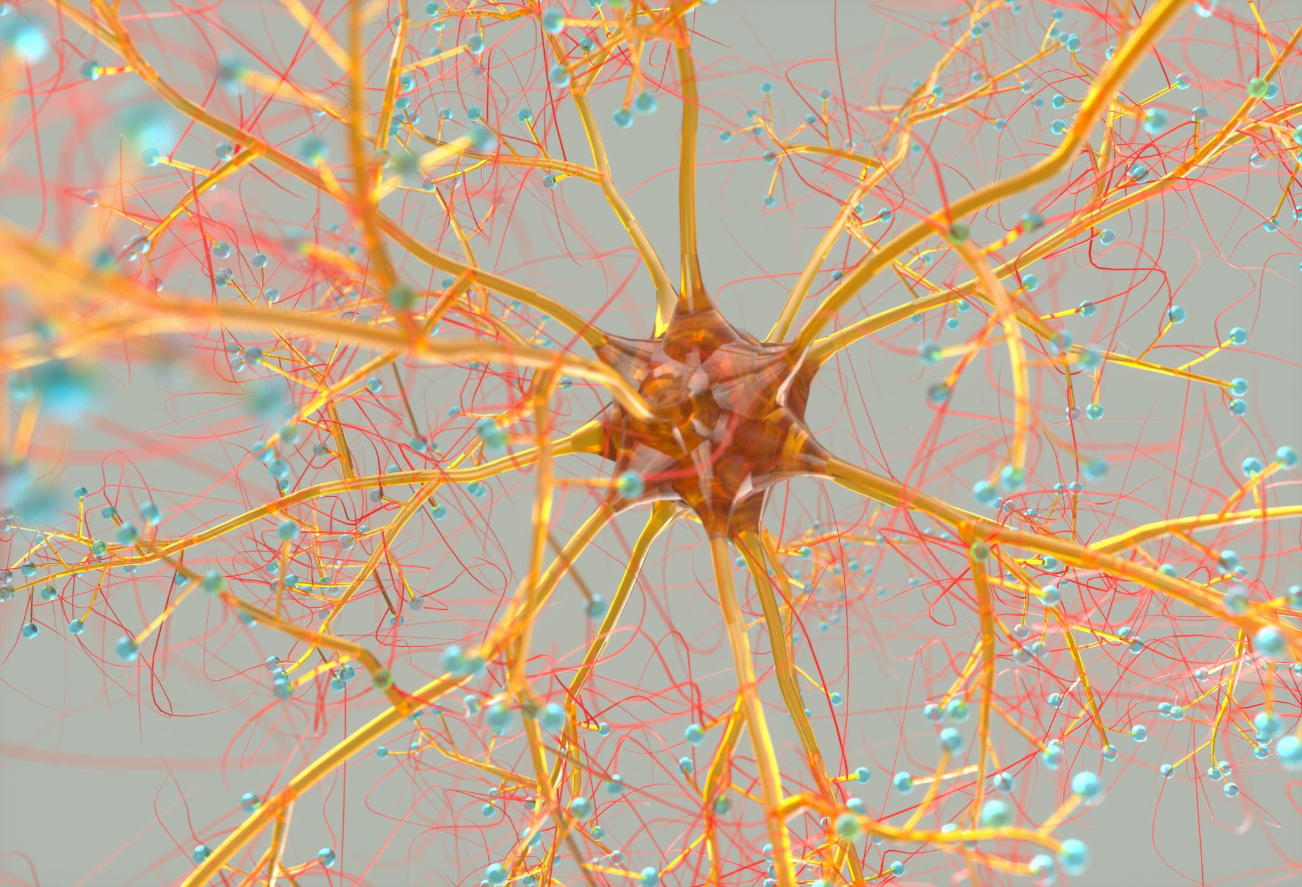
Neural Networks
Overview of neural networks
How neural networks work
Types of neural networks (feedforward, recurrent, convolutional)

Slide 13
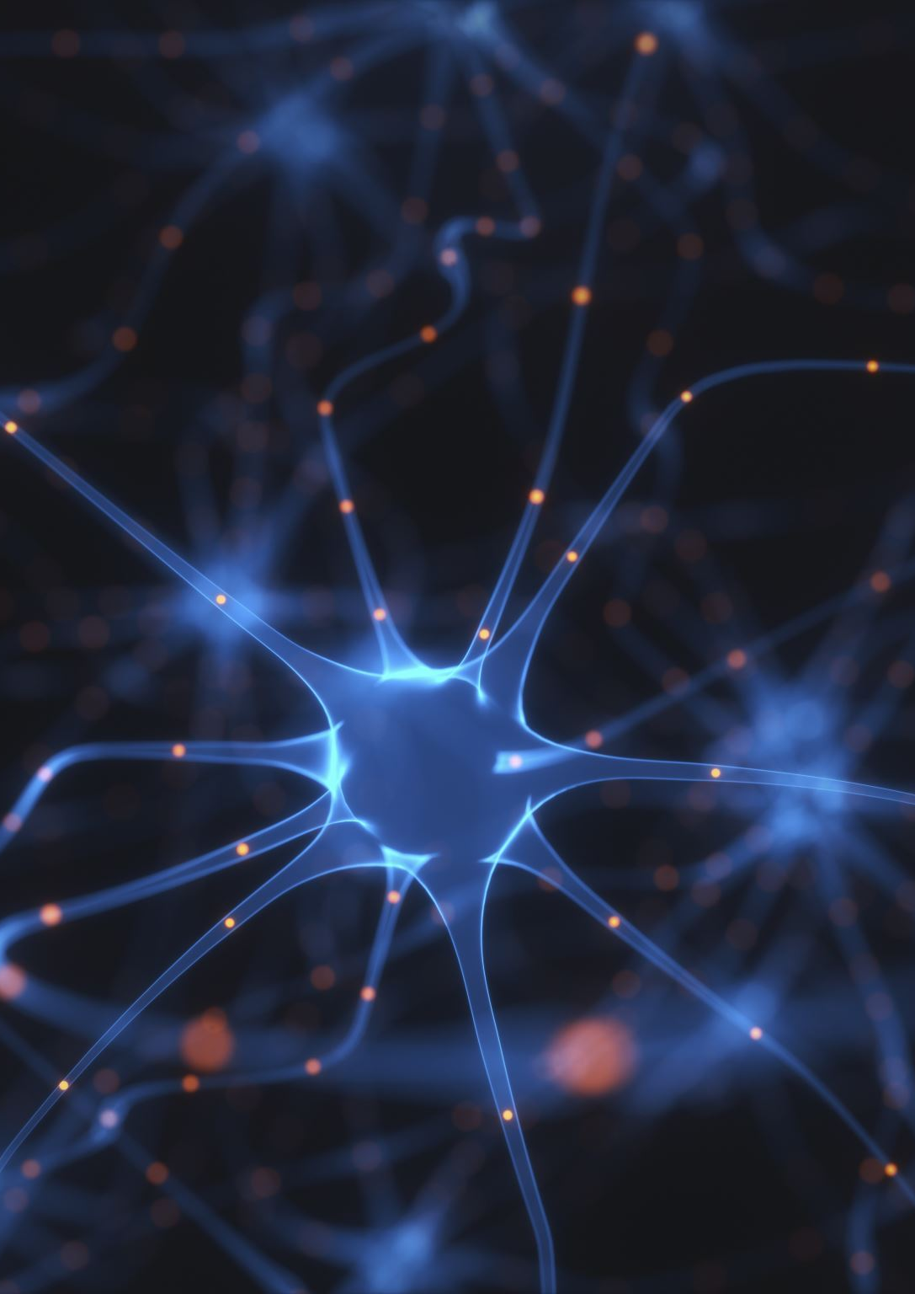
Overview of neural networks
A neural network is a type of machine learning algorithm modeled after the structure and function of the human brain.
It is composed of layers of interconnected "neurons," which process and transmit information. The goal of a neural network is to learn from input data and make predictions or decisions about new data.
There are several types of neural networks, including feedforward networks, recurrent networks, and convolutional networks. Each type is suited for different types of problems and data.
The process of training a neural network involves feeding it large amounts of labeled data, and adjusting the network's parameters (also known as weights) to minimize the error between its predictions and the true values. This process is known as backpropagation.

Slide 14
Overview of neural networks
Neural networks have been successfully applied to a wide range of tasks, including image and speech recognition, natural language processing, and game playing. They are also used in various industries, such as finance, healthcare, and transportation.
However, neural networks can also be complex and computationally expensive, and they may not always provide clear insights into how they arrive at their decisions. Therefore, it is important to carefully evaluate the performance and interpretability of a neural network before using it in real-world applications.

Slide 15
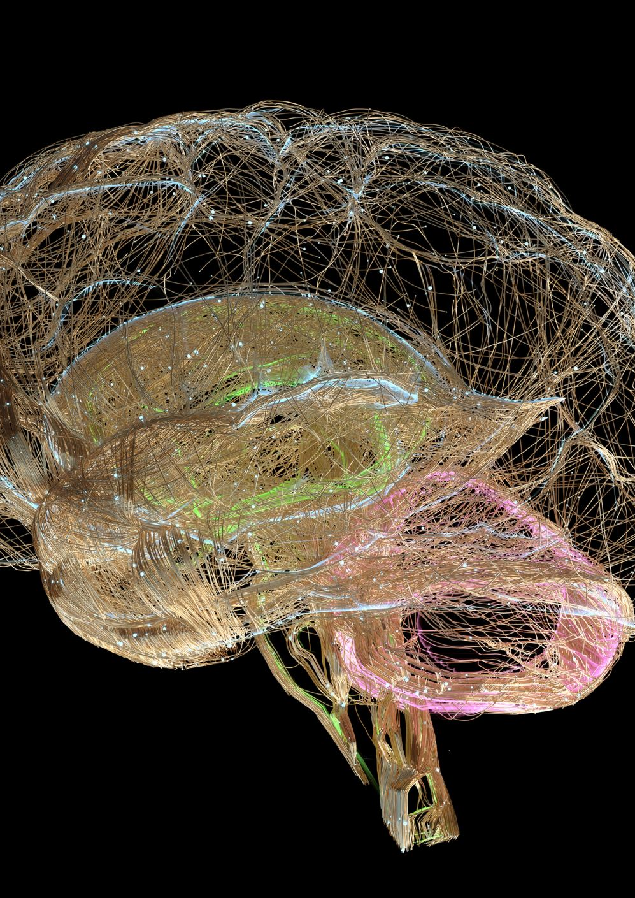
How neural networks work
Neural networks are a type of machine learning algorithm modeled after the structure and function of the human brain.
They consist of layers of interconnected "neurons," which process and transmit information.
Each neuron receives input, performs a computation on that input, and produces an output.
The output of one layer becomes the input for the next layer, and so on, until the final output is produced.
The computations performed by the neurons are determined by a set of learned parameters, called weights, which are adjusted during the training process to minimize the error between the network's predictions and the correct output.
Neural networks are commonly used for tasks such as image recognition, natural language processing, and game playing.

Slide 16
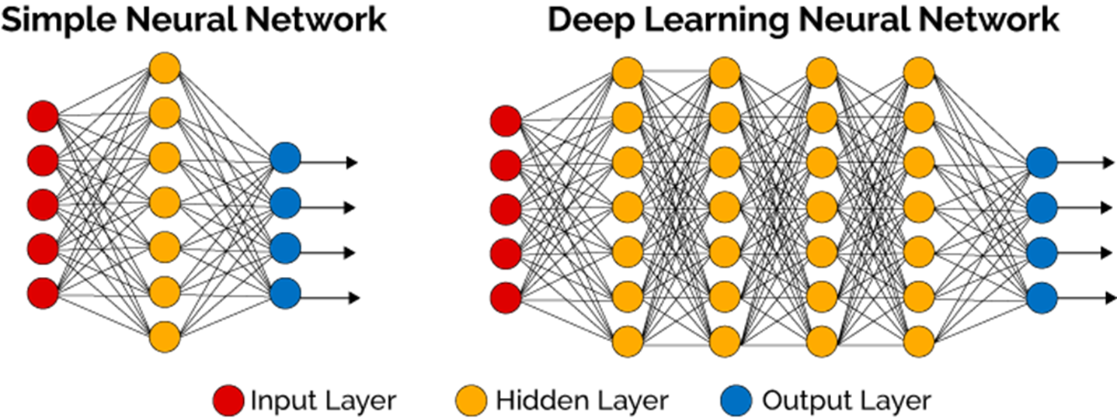
Neural Network

Slide 17
Types of neural networks (feedforward, recurrent, convolutional)
Feedforward Neural Network: A feedforward neural network is a type of neural network where the information flows in one direction, from input layer to output layer, without any loops or cycles. The output of one layer serves as the input for the next layer, and there is no feedback or recursion. These networks are used for tasks such as image classification, speech recognition, and natural language processing.
Recurrent Neural Network (RNN): A recurrent neural network is a type of neural network that has feedback or recursion in its architecture, allowing information to flow in both directions. This allows the network to maintain a memory of previous inputs, making it useful for tasks such as natural language processing, speech recognition, and time series prediction.
Convolutional Neural Network (CNN): A convolutional neural network is a type of neural network that is specifically designed for image and video processing tasks. It uses a technique called convolution, which involves applying a set of filters to the input image to extract features. CNNs are commonly used for tasks such as image classification, object detection, and image segmentation.

Slide 18
Deep Learning Architectures
Overview of deep learning architectures
Convolutional neural networks (CNN)
Recurrent neural networks (RNN)
Generative Adversarial Networks (GAN)

Slide 19
Overview of deep learning architectures
Deep learning is a subset of machine learning that uses neural networks with multiple layers to process and analyze large amounts of data. These architectures are designed to mimic the way the human brain processes information.
1.Feedforward Neural Networks (FFNN): These are the most basic type of neural networks, where information flows in one direction from input to output. They consist of an input layer, one or more hidden layers, and an output layer. FFNNs are used for tasks such as image classification and natural language processing.
2.Recurrent Neural Networks (RNN): These networks are designed to process sequential data, such as time series or speech. They have a hidden state that is updated at each time step, allowing them to maintain a memory of previous inputs. RNNs are used for tasks such as language translation and speech recognition.

Slide 20
Overview of deep learning architectures
3.Convolutional Neural Networks (CNN): These networks are designed to process image and video data. They use convolutional layers to extract features from the input data and are often used for tasks such as image classification and object detection.
4.Generative Adversarial Networks (GAN): These networks consist of two neural networks, a generator and a discriminator. The generator creates fake data, while the discriminator attempts to distinguish between real and fake data. GANs are used for tasks such as image synthesis and style transfer.
5.Autoencoder: These are neural networks that are trained to reconstruct their input data. They consist of an encoder and a decoder, where the encoder maps the input to a lower-dimensional representation, and the decoder maps it back to the original space. Autoencoders are used for tasks such as image compression and anomaly detection.

Slide 21
Training Deep Learning Models
Overview of training deep learning models
Common techniques (backpropagation, gradient descent, Adam optimization)
Common challenges (overfitting, underfitting)

Slide 22
Overview of training deep learning models
Training deep learning models involves several steps and can be a complex process. The following is an overview of the general steps involved in training a deep learning model:
Data preparation: The first step is to prepare the data that will be used to train the model. This includes cleaning, preprocessing, and formatting the data so that it can be fed into the model.
Network architecture: The next step is to design the architecture of the deep learning model. This includes choosing the number of layers, the type of layers, and the number of neurons in each layer.
Model compilation: The model is then compiled by defining the optimizer, loss function, and metrics that will be used to evaluate the model's performance.

Slide 23
Overview of training deep learning models
4.Training: The model is then trained on the prepared data using the defined optimizer and loss function. This process involves passing the data through the network and adjusting the weights and biases of the network to minimize the loss.
5.Evaluation: The model is then evaluated on a separate set of data to assess its performance. This includes measuring metrics such as accuracy, precision, and recall.
6.Fine-tuning: Based on the evaluation results, the model may need to be fine-tuned by adjusting the architecture, optimizer, or other parameters. The training and evaluation steps are then repeated until the desired performance is achieved.

Slide 24
Overview of training deep learning models
7.Deployment: Once the model has been trained and fine-tuned, it can be deployed in production to make predictions on new data.
Overall, training deep learning models is an iterative process that requires a good understanding of the data, the model architecture, and the optimization techniques. It can be time-consuming and requires significant computational resources. However, the results can be highly accurate and can be used to solve complex problems in a wide range of fields.

Slide 25
Common techniques (backpropagation, gradient descent, Adam optimization)
Backpropagation: Backpropagation is a supervised learning algorithm that is used to train artificial neural networks. It is used to calculate the gradient of the error function with respect to the weights of the network, allowing for the adjustment of the weights to reduce the error.
Gradient Descent: Gradient descent is an optimization algorithm that is used to minimize the error function of a neural network. It works by iteratively adjusting the weights of the network in the direction of the negative gradient of the error function.
Adam Optimization: Adam is an optimization algorithm that is based on gradient descent. It uses adaptive learning rates to adjust the weights of the network, making it more efficient and faster than traditional gradient descent methods. It also uses momentum to smooth out the optimization process and prevent overshooting of the optimal solution.

Slide 26
Common challenges (overfitting, underfitting)
Overfitting and underfitting are two common challenges in machine learning.
Overfitting occurs when a model is too complex and is able to fit the noise in the training data, rather than the underlying pattern. As a result, the model will perform well on the training data but poorly on new, unseen data.
Underfitting, on the other hand, occurs when a model is too simple and is unable to capture the underlying pattern in the data. As a result, the model will perform poorly on both the training and new data.
Both overfitting and underfitting can be addressed by using techniques such as cross-validation, regularization, and ensemble methods. Additionally, choosing a more appropriate model architecture or adjusting the model's hyperparameters can help to alleviate these issues.

Slide 27
Applications of Deep Learning
Computer vision (image classification, object detection)
Natural Language Processing (NLP)
Robotics
Self-driving cars

Slide 28
Computer vision (image classification, object detection)
Computer vision is a field of artificial intelligence that focuses on the ability of machines to interpret and understand visual information from the world around them. It is used in a variety of applications, including image classification and object detection.
Image classification is the process of identifying and classifying objects within an image. This can be done using machine learning algorithms that are trained on a dataset of labeled images. The algorithm learns to recognize patterns and features within the images, and is then able to classify new images based on those patterns.
Object detection is the process of identifying and locating objects within an image or video. This can be done using a variety of techniques, including convolutional neural networks (CNNs) and deep learning. Object detection algorithms are trained on a dataset of labeled images and videos, and are able to detect and locate objects within new images and videos based on the patterns and features learned during training.
Computer vision is used in a variety of applications, including self-driving cars, security systems, and image-based search engines. It is also used in medical imaging, robotics, and manufacturing.

Slide 29
Natural Language Processing (NLP)
Natural Language Processing (NLP) is a field of artificial intelligence and computational linguistics that deals with the interactions between human language and computers. It involves using algorithms and statistical models to analyze, understand, and generate human language. NLP is used in a variety of applications, such as speech recognition, natural language understanding, sentiment analysis, text summarization, and machine translation. The goal of NLP is to enable computers to understand and process human language in a way that is similar to how humans do.

Slide 30
Robotics
Robotics is the branch of engineering and science that deals with the design, construction, operation, and use of robots. Robots are machines that are capable of performing a wide range of tasks, from simple repetitive tasks to complex and delicate operations. Robotics technology is used in many different fields, including manufacturing, healthcare, transportation, and even space exploration. Robotics technology is constantly advancing, with new developments in areas such as artificial intelligence, machine learning, and autonomous systems.

Slide 31
Self-driving cars
Self-driving cars, also known as autonomous vehicles, are vehicles that are able to navigate and operate without human input. They use a combination of sensors, cameras, and advanced algorithms to detect and respond to their environment, including other vehicles, pedestrians, and obstacles. These cars are designed to improve safety, reduce traffic congestion, and increase mobility for those who are unable to drive. However, there are still many challenges to be overcome before self-driving cars can become a reality on public roads, including regulatory and legal issues, cybersecurity concerns, and public acceptance.

Slide 32
Conclusion
Recap of key points
Future of deep learning
Resources for further learning.

Slide 33
Recap of key points
We discussed about:
Definition of deep learning,Importance and applications of deep learning
Overview of neural networks,How neural networks work,Types of neural networks (feedforward, recurrent, convolutional)
Overview of deep learning architectures,Convolutional neural networks (CNN),Recurrent neural networks (RNN),Generative Adversarial Networks (GAN)
Overview of training deep learning models,Common techniques (backpropagation, gradient descent, Adam optimization),Common challenges (overfitting, underfitting)
Applications of Deep Learning,Computer vision (image classification, object detection),Natural Language Processing (NLP),Robotics,Self-driving cars

Slide 34
Future of deep learning
The future of deep learning is expected to continue to evolve and expand in various industries and fields. Some potential areas of growth include:
Autonomous vehicles: Deep learning will play a significant role in the development of self-driving cars, enabling them to make decisions based on real-time data and adapt to changing conditions on the road.
Healthcare: Deep learning algorithms are already being used to improve medical imaging and diagnostic tools, and in the future, they may be used to analyze large amounts of patient data and make personalized treatment recommendations.
Robotics: Deep learning will be used to develop robots that can perform tasks such as object recognition and manipulation, and even natural language processing.

Slide 35
Future of deep learning
4.Natural Language Processing (NLP): Deep learning is helping NLP to become more sophisticated, allowing computers to understand human language more accurately.
5.Cybersecurity: Deep learning can be used to detect and prevent cyber attacks, by analyzing patterns in network traffic and identifying potential threats.
6.Gaming: Deep learning is already being used to improve the realism and intelligence of non-player characters in video games, and in the future, it may be used to create more immersive and personalized gaming experiences.
Overall, deep learning has the potential to revolutionize many industries and improve the way we live and work.

Slide 36
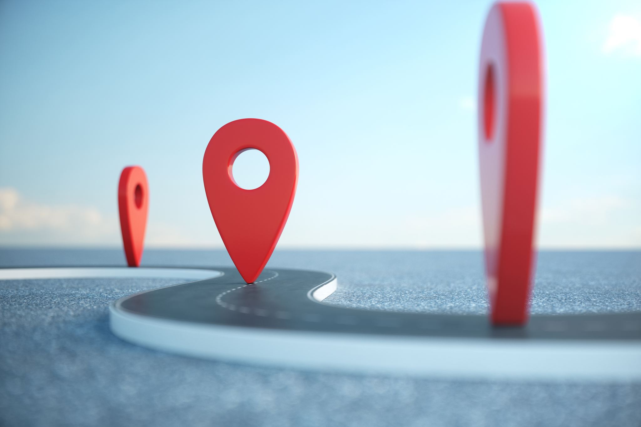
Resources for further learning.
https://keras.io/
https://www.deeplearning.ai/
https://skillsbuild.org/

Slide 37
Practical Demo
Implementation of Shallow NN and Deep NN using Tensor Flow and Keras

Slide 38
TensorFlow
TensorFlow is an open-source software library for machine learning developed by Google Brain Team. It is used for a wide range of applications, including image and speech recognition, natural language processing, and predictive analytics. TensorFlow allows developers to build and deploy machine learning models easily and efficiently. It provides a comprehensive set of tools and libraries for creating, training, and deploying neural networks. TensorFlow also supports distributed computing, allowing models to be trained on large datasets across multiple machines.

Slide 39
Keras
Keras is an open-source neural network library written in Python. It is designed to be user-friendly and modular, allowing for easy and fast prototyping of deep learning models. Keras provides a high-level API for building and training neural networks, and it can run on top of TensorFlow, Theano, or CNTK backends. It supports a wide range of architectures, including convolutional neural networks (CNNs), recurrent neural networks (RNNs), and deep belief networks (DBNs). Keras also includes a variety of pre-processing and data augmentation tools, making it a popular choice for computer vision and natural language processing tasks.

Slide 40
Artificial Neural Network (ANN)
An Artificial Neural Network (ANN) is a type of machine learning algorithm that is modeled after the structure and function of the human brain. It is made up of layers of interconnected "neurons" that are designed to process and analyze large amounts of data. These neurons are connected to each other through "synapses," which allow them to communicate and share information.
ANNs are used for a wide range of tasks, including image recognition, natural language processing, and predictive modeling. They are particularly useful for tasks that involve large amounts of data, as they are able to learn from the data and make predictions or decisions based on it.
There are several different types of ANNs, including feedforward networks, recurrent networks, and convolutional networks. Each type is designed for specific tasks and has its own strengths and weaknesses.
Overall, ANNs are an important tool in the field of machine learning and artificial intelligence, and are widely used in a variety of applications.

Slide 41
Shallow ANN
A shallow ANN, also known as a single-layer neural network, is a type of artificial neural network that has only one layer of neurons. It is considered a basic type of neural network and is typically used for simple tasks such as pattern recognition and classification. It is not as powerful as deeper neural networks, but it is easy to implement and can be used as a building block for more complex architectures.

Slide 42
Deep NN
A deep neural network (deep NN) is a type of artificial neural network that is composed of multiple layers of interconnected nodes, or "neurons." These layers are referred to as "hidden layers" because they are not directly connected to the inputs or outputs of the network. The more hidden layers a deep NN has, the more complex and powerful it is, making it capable of tackling more difficult problems and achieving better performance. Deep NNs are commonly used for tasks such as image recognition, natural language processing, and speech recognition.

Slide 43
Flatten layer
A flatten layer is a type of neural network layer that is used to convert multi-dimensional input data into a single dimension. This is typically used to prepare data for use in fully connected layers, which require input data to be in a single dimension. The flatten layer takes the input data, which may be a multi-dimensional array, and flattens it into a single dimension by reshaping and concatenating the data. This allows for easier processing and manipulation of the data in the following layers.

Slide 44
Dense layer
A dense layer, also known as a fully connected layer, is a type of neural network layer where all the neurons in the previous layer are connected to all the neurons in the current layer. This means that each neuron in the dense layer receives inputs from all the neurons in the previous layer. Dense layers are typically used for classification tasks and are often placed at the end of a neural network architecture. Top of Form

Slide 45
CIFAR-10 Dataset-
CIFAR-10 is a dataset of 60,000 32x32 color images in 10 classes, with 6,000 images per class. There are 50,000 training images and 10,000 test images. The classes include airplane, automobile, bird, cat, deer, dog, frog, horse, ship, and truck. This dataset is widely used in computer vision research and is a benchmark for image classification tasks.

Slide 46
Demo 1

Slide 47
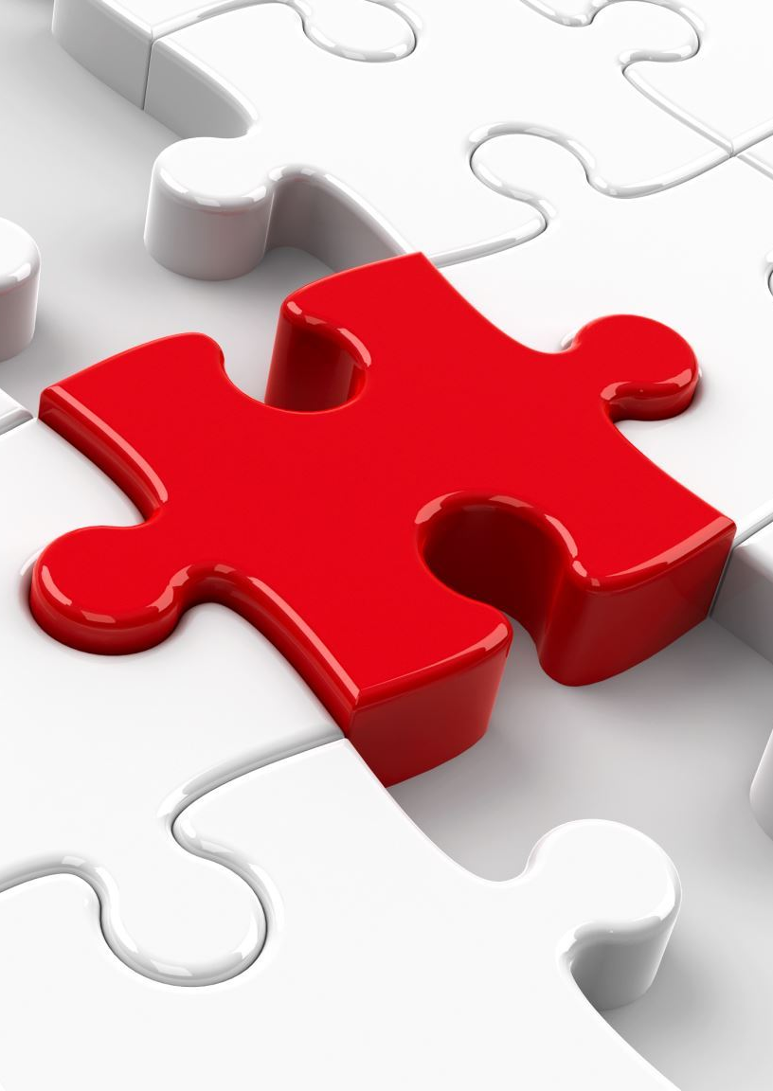
Problem statement 1
Design and Develop a neural network model with 2 layers (flatten and dense) using the CIFAR-10 dataset.
•Filename- ANN-CIFAR10-KEARS.ipynb

Slide 48
Steps :
Import
Import the necessary library- tensorflow, keras
Load
Load the Dataset CIFAR10
Normalize
Normalize the data -The data is first normalized by dividing by 255.
Create
Create a shallow neural network with 2 layers ((flatten and dense)
Compile
Compile the model
Train
train the model (Model is trained and evaluated using the Adam optimizer, sparse categorical cross-entropy loss, and accuracy as the evaluation metric.)
Evaluate
Evaluate the model-The final output is the test accuracy of the model.

Slide 49
Steps : 1. Import the necessary library- tensorflow, keras
import tensorflow as tf
from tensorflow import keras
from keras.datasets import cifar10

Slide 50
Steps : 2.Load the Dataset-CIFAR10
(x_train, y_train), (x_test, y_test) = cifar10.load_data()

Slide 51
Steps : 3.Normalize the data -The data is first normalized by dividing by 255.
x_train = x_train / 255.0
x_test = x_test / 255.0

Slide 52
Steps : 4.Create a shallow neural network with 2 layers ((flatten and dense)
model = keras.Sequential()
model.add(keras.layers.Flatten())
model.add(keras.layers.Dense(128, activation='relu'))
model.add(keras.layers.Dense(10, activation='softmax'))

Slide 53
Steps : 5.Compile the model
#(Model is trained and evaluated using the Adam optimizer, sparse categorical cross-entropy loss, and accuracy as the evaluation metric.)
# compile the model
model.compile(optimizer='adam', loss='sparse_categorical_crossentropy', metrics=['accuracy'])

Slide 54
Steps : 6. Train the model # train the model
model.fit(x_train, y_train, epochs=10)

Slide 55
Steps : 7.Evaluate the model-The final output is the test accuracy of the model.
test_loss, test_acc = model.evaluate(x_test, y_test)
print('Test accuracy:', test_acc)

Slide 56
Demo 2

Slide 57
Problem statement 2-
Design and Develop deep learning model for the CIFAR-10 dataset in Python using the Keras library.
Filename- CNN-CIFAR-10-Keras.ipynb

Slide 58
Steps :
Import the necessary library- tensorflow, keras
Load the CIFAR-10 dataset
Preprocess the data
Define the model
Compile the model
Train the model
Evaluate the model on the test set

Slide 59
Steps :1. Import the necessary library- tensorflow, keras
from keras.datasets import cifar10
from keras.models import Sequential
from keras.layers import Dense, Dropout, Flatten, Conv2D, MaxPooling2D
from keras.utils import to_categorical

Slide 60
Steps : 2. Load the CIFAR-10 dataset
(x_train, y_train), (x_test, y_test) = cifar10.load_data()

Slide 61
Steps : 3.Preprocess the data
x_train = x_train.astype('float32') / 255.0
x_test = x_test.astype('float32') / 255.0
y_train = to_categorical(y_train, 10)
y_test = to_categorical(y_test, 10)

Slide 62
Steps : 4.Define the model
model = Sequential()
model.add(Conv2D(32, (3, 3), activation='relu', input_shape=(32, 32, 3)))
model.add(MaxPooling2D(pool_size=(2, 2)))
model.add(Conv2D(64, (3, 3), activation='relu'))
model.add(MaxPooling2D(pool_size=(2, 2)))
model.add(Flatten())
model.add(Dense(1024, activation='relu'))
model.add(Dropout(0.5))
model.add(Dense(10, activation='softmax'))

Slide 63
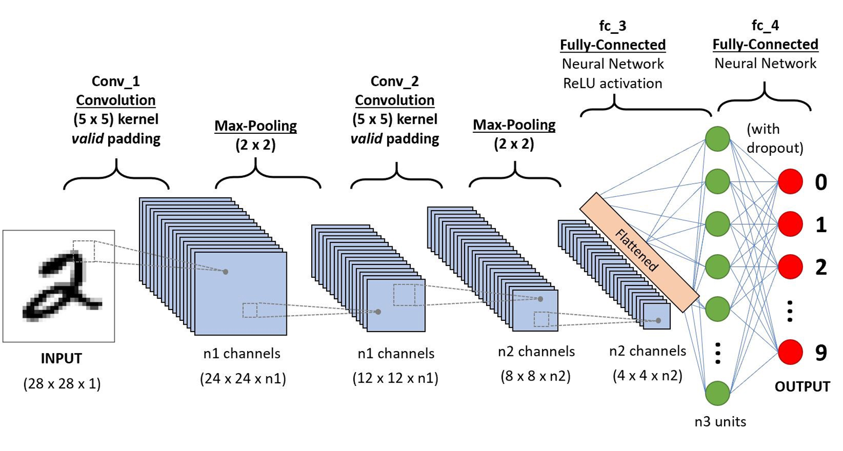

CNN

Slide 64
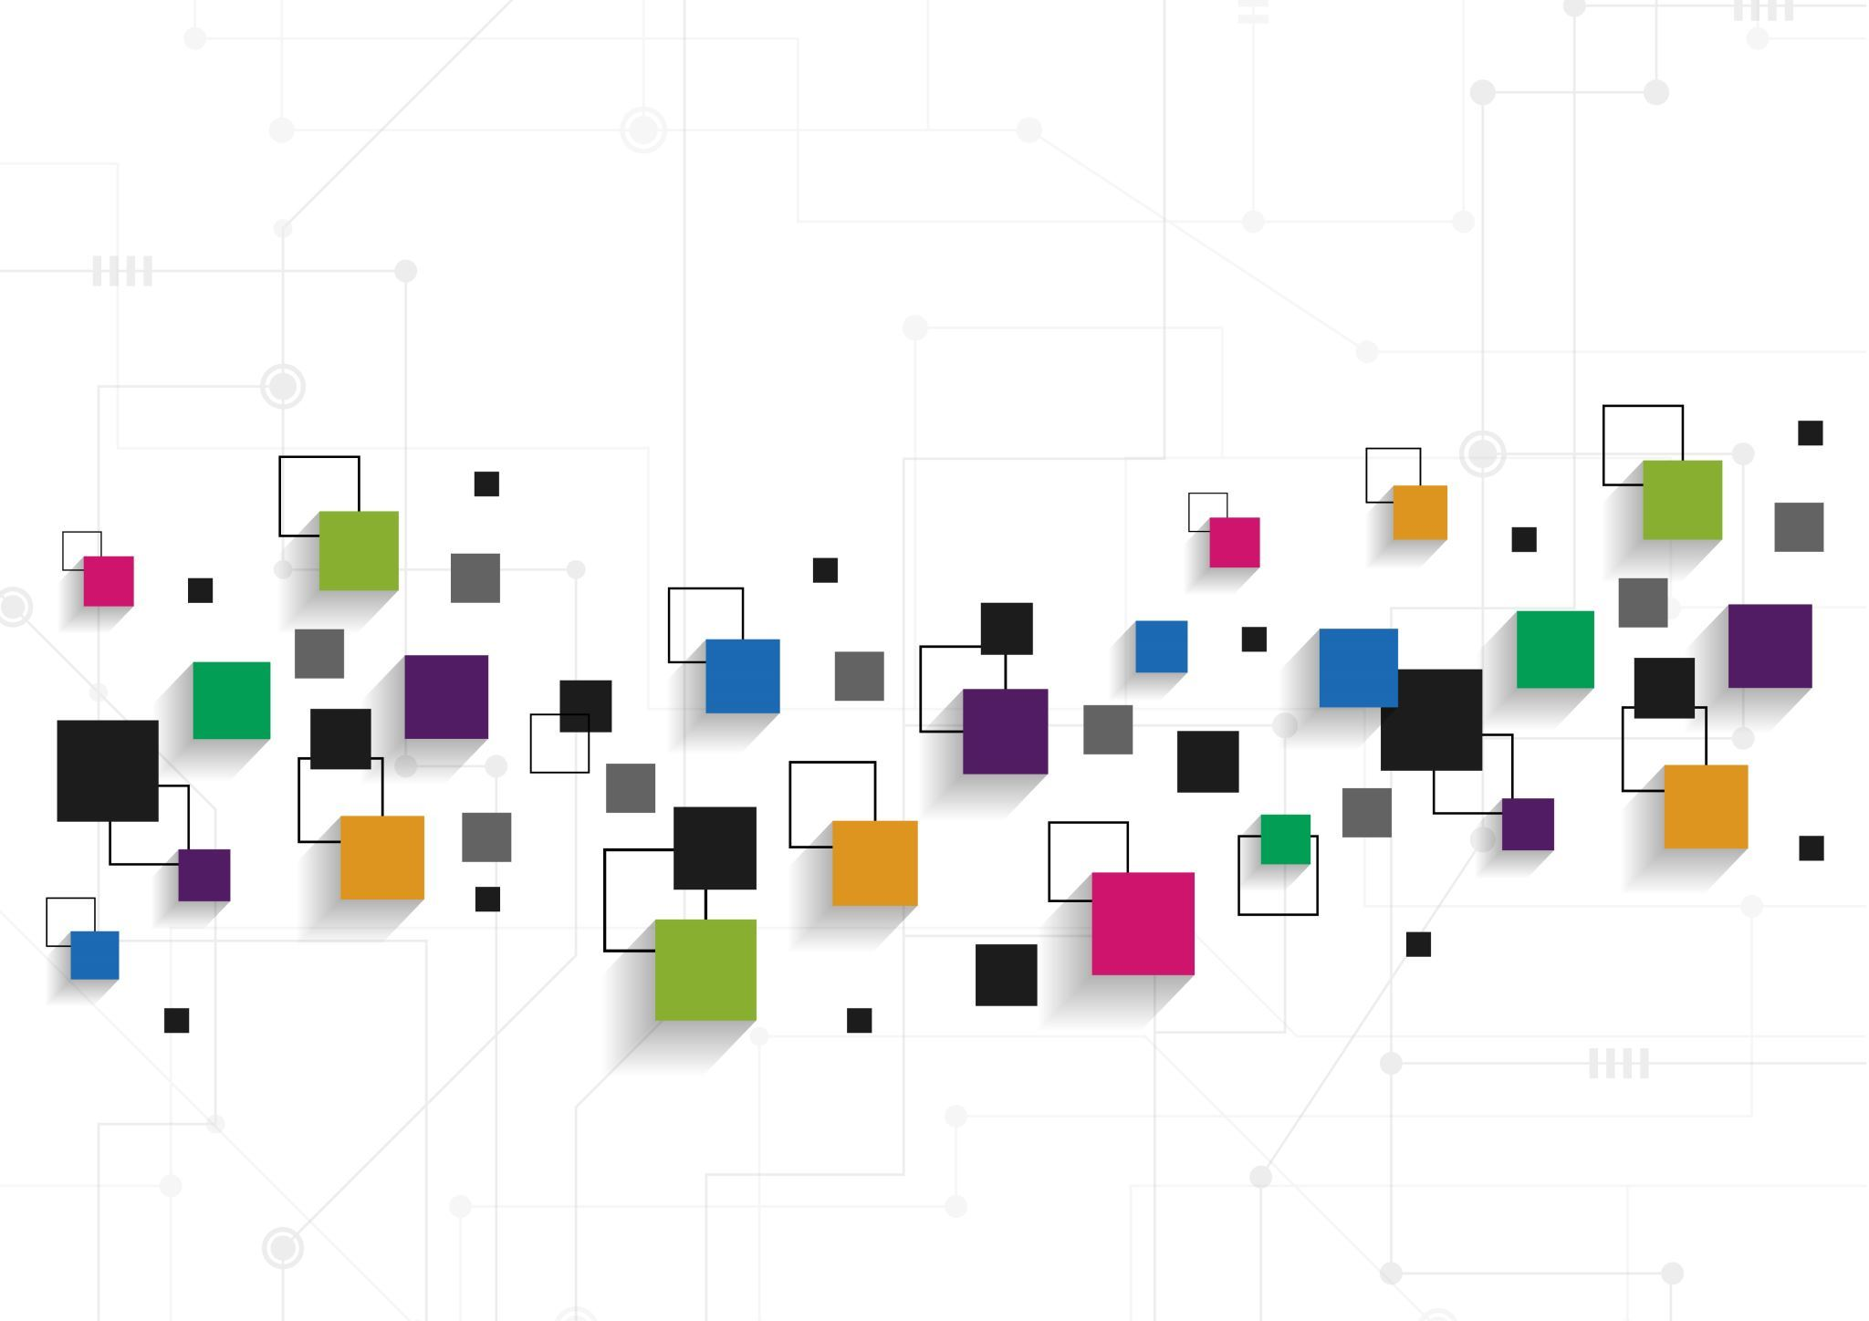
Steps : 4.Define the model
Conv2D-
Conv2D is a convolutional layer in a deep learning network. It performs convolution operations on an image or other input data to extract features from the data. It allows for the creation of more complex models that can better identify patterns in the data. Conv2D is commonly used for image recognition and classification tasks.

Slide 65
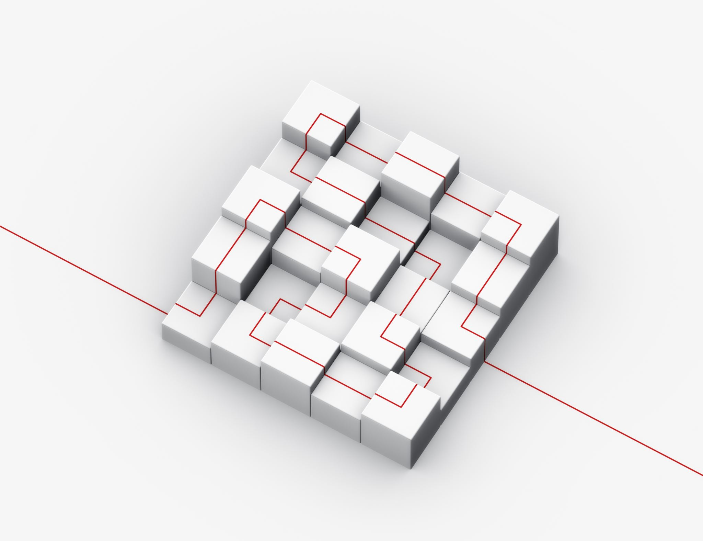
Steps : 4.Define the model
MaxPooling2D-
MaxPooling2D is a pooling layer used in convolutional neural networks. It partitions the input image into a set of non-overlapping rectangles and, for each such sub-region, outputs the maximum value. This reduces the dimensionality of the input image while retaining the most important information. It also helps to reduce computation time by reducing the number of parameters to learn.

Slide 66
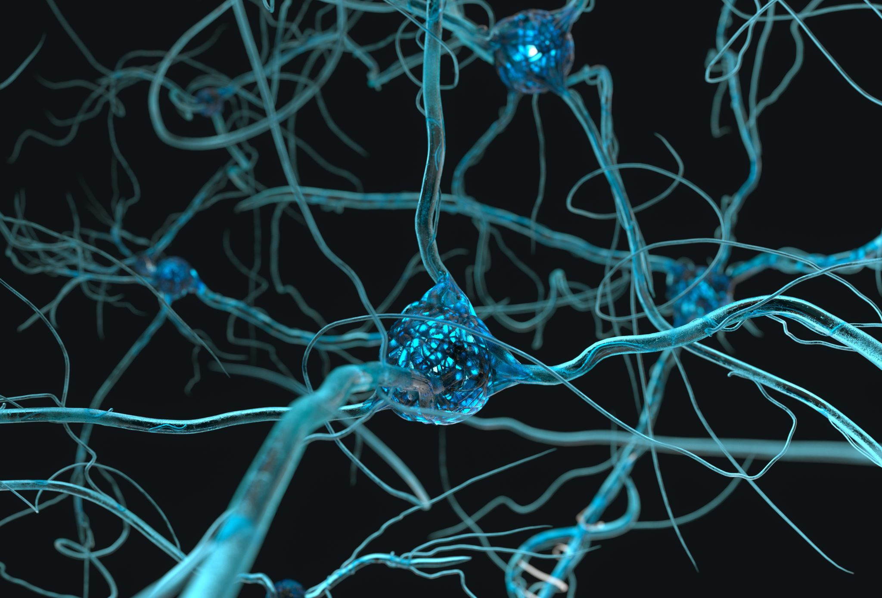
Steps : 4.Define the model
Dropout
Dropout is a technique in which randomly selected neurons are ignored during training. It is a regularization method which helps in reducing overfitting. It works by temporarily dropping out units (neurons) from the network, along with their connections, so that other neurons cannot rely on the output of the dropped-out neurons. This forces the network to learn features in a distributed way, improving generalization capabilities of the model.

Slide 67
Steps : 4.Define the model
model = Sequential()
model.add(Conv2D(32, (3, 3), activation='relu', input_shape=(32, 32, 3)))
model.add(MaxPooling2D(pool_size=(2, 2)))
model.add(Conv2D(64, (3, 3), activation='relu'))
model.add(MaxPooling2D(pool_size=(2, 2)))
model.add(Flatten())
model.add(Dense(1024, activation='relu'))
model.add(Dropout(0.5))
model.add(Dense(10, activation='softmax'))

Slide 68
Steps : 5. Compile the model
model.compile(optimizer='adam', loss='categorical_crossentropy', metrics=['accuracy'])

Slide 69
Steps : 6.Train the model
model.fit(x_train, y_train, epochs=10, batch_size=32)

Slide 70
Steps : 7.Evaluate the model on the test set
test_loss, test_acc = model.evaluate(x_test, y_test)
print('Test accuracy:', test_acc)

Slide 71
Thank you

